Slide 1


Prediction of Termination
Team Frog
Team Member: Shilong Zong
Course Section: CS513-A
Department: Computer Science
Level: Undergraduate
Team Member: Yi Jing
Course Section: CS513-A
Department: Computer Science
Level: Undergraduate

Slide 2
Features and Data
TERMINATION_YEAR is actually the termination statues. Remove it.
EMP_ID, not a predictor. Remove it.
JOB_CODE is similar to JOB_GROUP. Remove it.
Transform .NUMBERS data to CSV data.
Total 9612 observations, 5394 are still active, and 4218 are terminated. The class is relatively balanced. Split the train and test using 8:2.

Slide 3
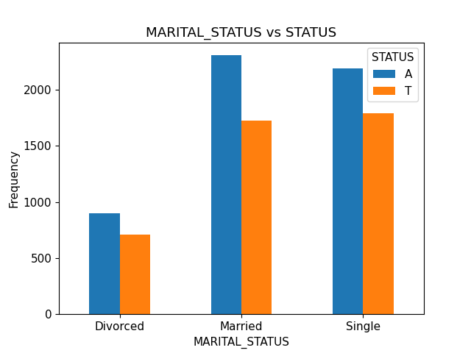
A simple data analysis: Male is slightly more likely to not terminate. Married employee is slightly more likely to be with the company.

Slide 4
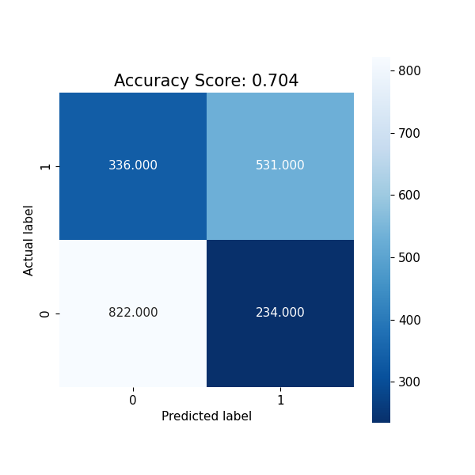
Prediction Model 1 Logistic Regression with L1 regularization
Training Accuracy: 0.71
Test Accuracy: 0.70
No obvious overfitting.

Slide 5
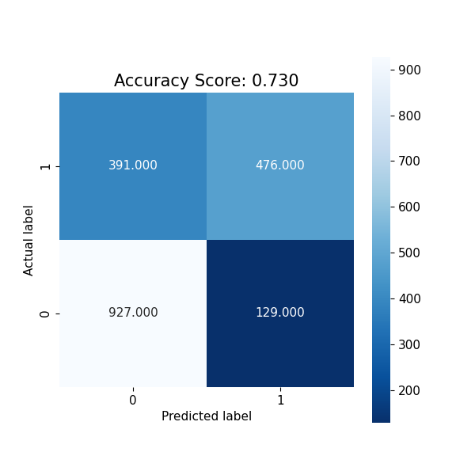
Prediction Model 2 Random Forest
Number of Trees 150, max depth 12:
Training Accuracy: 0.82
Test Accuracy: 0.73
No obvious overfitting.
Best performance is from:
Number of Trees 200, max depth 11:
Training Accuracy: 0.79
Test Accuracy: 0.73
Reduce the overfitting, and keeps the performance on test dataset.

Slide 6
Prediction Model 3 XGBoost
Best performance is from:
Number of Trees 200, max depth 11:
Training Accuracy: 0.93
Test Accuracy: 0.77
All possible sets of hyperparameters have overfitting. But this set gives the best test accuracy.

Slide 7
Conclusion
Ensemble Model is generally better than single model.
But the overfitting problem exists.
The best performance is from XGBoost.

